Slide 1
PRE-SURVEY

Slide 2
Retrieval Augmented Generation (RAG)
Ashish
Senior Research Data Scientist
Rosen Center of Advanced Computing (RCAC)

Slide 3
Agenda
Explore Word embeddings
01
Overview of Vector Database
02
Semantic Search
03
RAG Framework
04

Slide 4
Fine Tuning v/s RAG

Slide 5
Fine Tuning
Query
Pre-training
Finetuning
{ }
User
Gigantic dataset
Base LLM
Pretend LLM
Response
Org/Domain
Specific dataset

Slide 6
Retrieval-Augmented Generation (RAG)
Pre-training
Query
{ }
Gigantic dataset
Base LLM
QA System
User
Response
Search
Query + relevant
docs
Org/Domain
Specific dataset

Slide 7
Key differences
Knowledge integration
Adaptability
Inference process
Resource requirements
Transparency and Explainability
Application suitability

Slide 8
Word Embeddings
Numerical Representation
Semantic Similarity
Machine Learning Integration
Dimensionality reduction
Context Sensitivity
Applications

Slide 9
Vector Database (Chroma DB)
AI-Focused Database
Easy to Use
Handles Complex Data Automatically
Advance Search Features
Flexible with Data
Community-Driven and Open Source

Slide 10
Semantic Search
Understanding Semantic Search
Use of Natural Language data
Vectorization of Text
Creating a searchable collection
Querying the collection
Retrieval of the results

Slide 11
Links
https://github.com/chroma-core/chroma (Chroma DB)
https://huggingface.co/sentence-transformers/all-MiniLM-L6-v2 (Sentence Transformer)
https://www.kaggle.com/datasets/unanimad/the-oscar-award/data (Dataset)

Slide 12
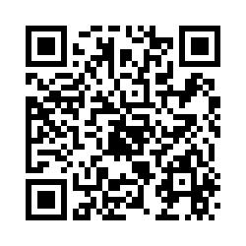
POST-SURVEY

